Slide 1
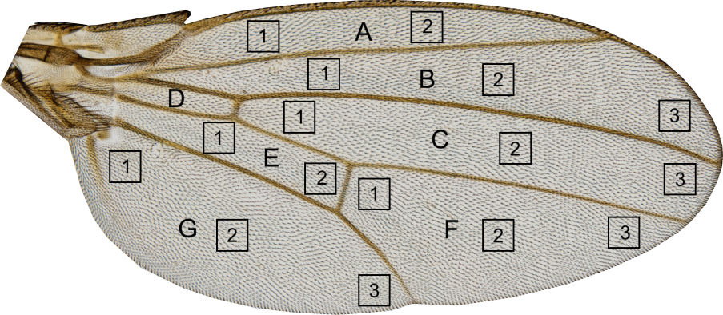
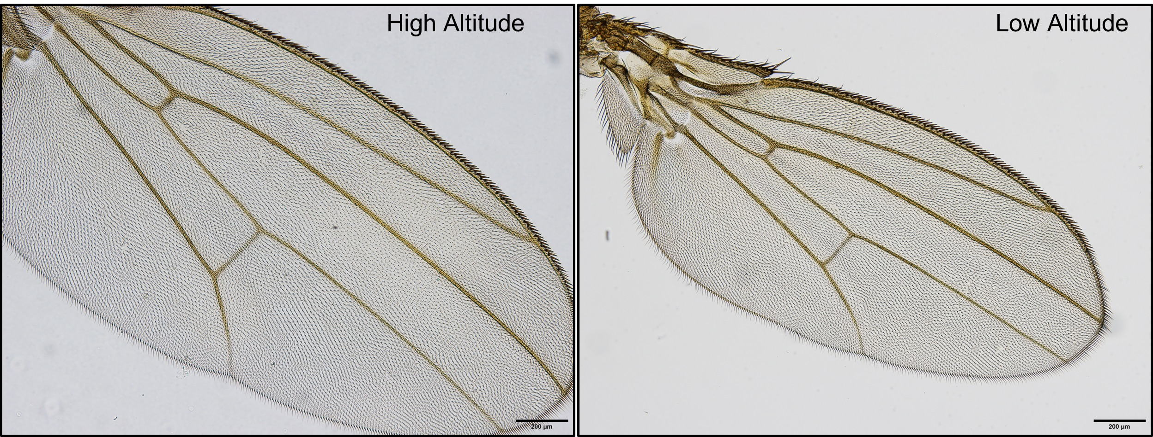
We use fruit fly (Drosophila) wing shape to study phenotypic evolution (using Genetics, Development and artificial selection)
Ethiopia
Zambia

Slide 2
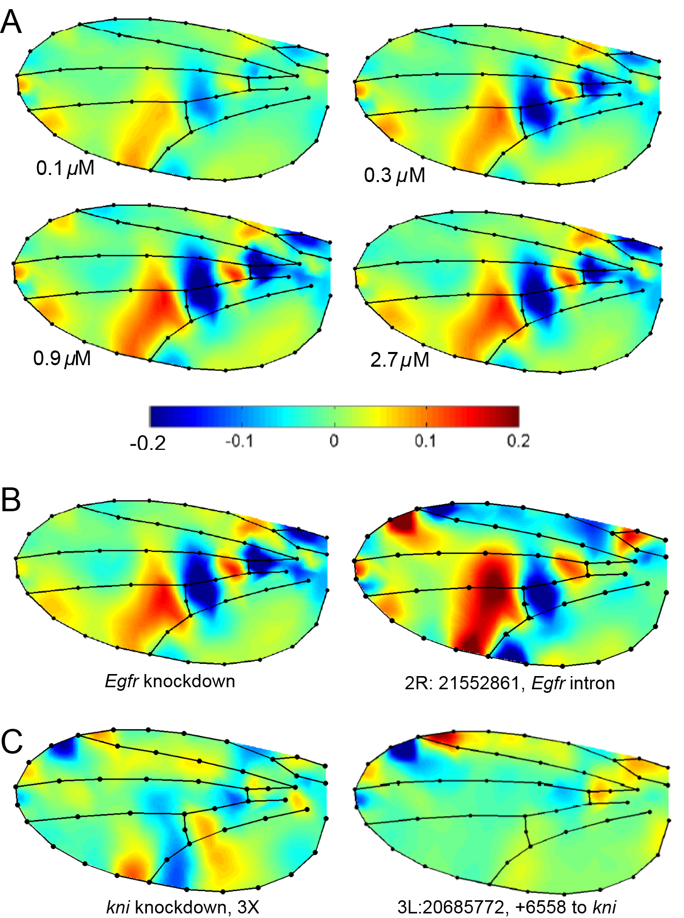
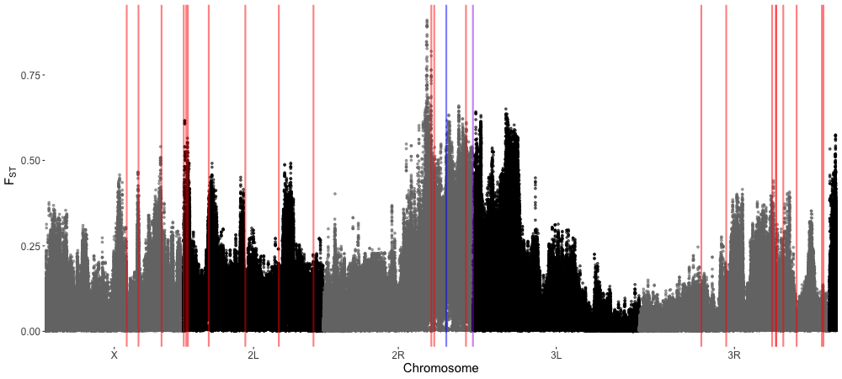
Studying genetic effects in nature and in the lab
Pitchers et al. 2019

Slide 3
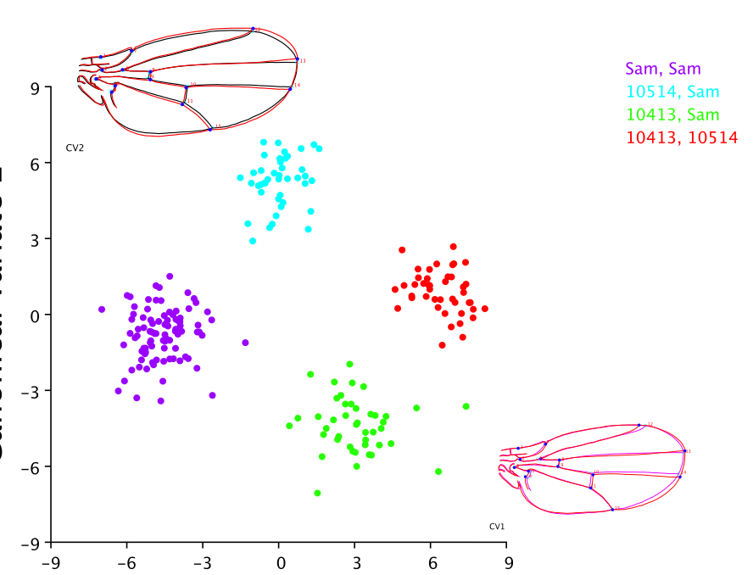
Methods to study epistasis (genetic interactions) for high dimensional phenotypes
G1
Hypothetical additive (G1 + G2)
G1:G2 (observed)
G2

Slide 4
Evolution, Genetics and Development of sexual shape dimorphism
Mutational perturbations
(growth regulators)
Intra-specific (genetic and nutritional effects)
Among Species
Sexual Shape Dimorphism
(total)
Sexual Size Dimorphism (SSD index)

Slide 5
What I obsess over (for GMM)
Effect sizes and their uncertainty (Confidence limits)
Visualizing uncertainty in shape plots
Regularization of effects
Appropriate ways of dealing with millions of genetic variants (GWAS, genome scans) associated with GMM data.

